Slide 1

Software Engineering (CS3201) Requirements Engineering
Avinash

Slide 2

Requirements Engineering

Slide 3
Introduction
Involves three key activities
Requirements Elicitation (and Analysis)
Requirements Specification
Requirements Validation
Requirements Elicitation: Discovering requirements by interacting with stakeholders
Requirements Specification: Converting requirements to standard form
Requirements Validation: Checking whether the requirements define what the customer wants

Slide 4
Introduction
The output of the RE process is a system requirements document

Slide 5
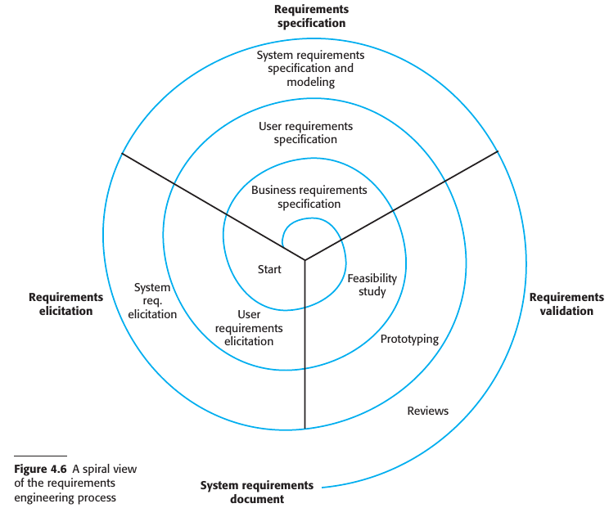
Introduction

Slide 6
Introduction
The time and effort devoted to each activity in each iteration depends on the type of system being developed and the budget
Early in the process – more effort on understanding high level business, non-functional and user requirements
Later in the process – more effort on eliciting and understanding the non-functional requirements and system requirements
Spiral allows development in different levels of detail
Number of iterations can vary, and can exit spiral at any stage (once you think you have gathered sufficient, and sufficient level, of requirements)

Slide 7
Introduction
Sometimes, Agile development can be used instead of prototyping so that the requirements and the system implementation are developed together (feedback and refinement)
In virtually all systems, requirements change
People develop a better understanding of what they want
Organization buying the system changes
Modifications are made to the system’s hardware, software, and organizational environment
Changes must be managed to understand the impact on other requirements and the cost and system implications of making the change (we will look into this in requirements management)

Slide 8
Business Requirements Specification?? Example
A Business Requirement Specification (BRS) is like defining the vision and goals for the Student Portal before getting into technical details
It answers the big questions
It answers:
Why is the system needed? (To improve efficiency in student services)
Who benefits? (Students, professors, administrators)
What should the system do? (Provide self-service, course management, messaging, etc.)

Slide 9
Feasibility study
Technical feasibility:
Can it be developed using existing technology
Does the university (or business) have the necessary hardware/software infrastructure?
Are the proposed features (e.g., AI-based student score predictions) technically achievable?
Can existing university databases integrate with the new portal?
Economic feasibility (Cost-benefit analysis):
Is the project financially practical?
What is the estimated budget for development and maintenance?
Will the benefits (e.g., improved efficiency, reduced manual work) outweigh the costs?
Can the university afford the necessary infrastructure upgrades?

Slide 10
Feasibility study
Legal and Compliance:
Does the system comply with relevant laws and regulations? (data storage and privacy laws, for example)
Operation feasibility:
Will users (students, professors, administrators) accept and use the system?
How will students register and access their courses?
Will professors be comfortable with online grading and communication?
Will training be needed for users?
Schedule feasibility:
Can the system be developed within the given time frame?
How long will it take to build, test, and deploy?
Are there critical deadlines (e.g., before the next semester begins)?

Slide 11
Requirements Elicitation
Aim:
Understand the new system needed / wanted
Understand the stakeholder work (needed for the following point)
How the new system will support/ improve the work
Software Engineers work with stakeholders to find out:
Application domain (where the application is to be used – university, hotel, etc.)
Work activities (general everyday tasks at work-place, some involve existing system, some manual)
Services and System features needed (functional requirements)
Required performance (non-functional requirements)
Hardware constraints

Slide 12
Requirements Elicitation
Challenges (of eliciting requirements from stakeholders):
Stakeholders do not know what they want from the system (except in most general terms)
Stakeholders express requirements in their own way (and with their own implicit knowledge of their own work)
Different stakeholders express requirements in different ways (requirements engineers then must check for commonality and resolve conflict)
The economic and business environment in which the analysis takes place is dynamic (importance and priority of requirements may change, new requirements may emerge)

Slide 13
Requirements Elicitation challenges - Examples
#1: Stakeholders don't know what they want (except in general terms)
"We need a system where students can register for courses"
Can they edit (add/ drop)? Prerequisites? What if some course is full? Are there limits?
#3: Different stakeholders express requirements in different ways
Students want an easy way to reset forgotten passwords via email.
IT security staff want a strict, multi-step authentication process to prevent hacking.
#2: Stakeholders express requirements in their own way (with own implicit knowledge)
"We need a system that supports a curved grading policy." - Professor X
What is curved – bell curve? Linear scaling? Professor assumes everyone understands grading policy, and is on the same grading policy
#4: The economic and business environment in which the analysis takes place is dynamic
The system should support credit and debit card payments.
Within 6 months, market trends indicate the usage of UPI. Somewhere down the line, cryptocurrency starts becoming prevalent, need to incorporate all these changes

Slide 14
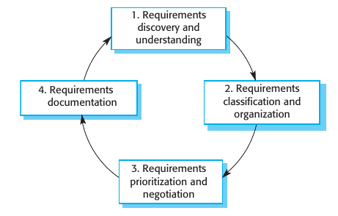
Requirements Elicitation

Slide 15
Requirements Elicitation
Requirements discovery and understanding: This is the process of interacting with stakeholders of the system to discover their requirements
Requirements classification and organization: This activity takes the unstructured collection of requirements; groups related requirements and organizes them into coherent clusters.

Slide 16
Requirements Elicitation
Requirements prioritization and negotiation: Inevitably, when multiple stakeholders are involved, requirements will conflict. This activity is concerned with prioritizing requirements and finding and resolving requirements conflicts
Requirements documentation: The requirements are documented and input into the next round of the spiral. An early draft of the software requirements documents may be produced

Slide 17
Requirements Elicitation Techniques
Requirements elicitation involves meeting stakeholders (of different kinds) to discover information about the proposed system
This can be supplanted with knowledge of existing systems and information from documents
Two fundamental approaches to elicit requirements:
Interviewing – talk to people about what they do
Observation or Ethnography – watch people at their job
You should use a mix of interviewing and observation – thereby derive requirements – which is then the basis for further discussion / work

Slide 18
Interviewing
Formal and/or informal interviews with system stakeholders
Puts questions to stakeholders about the system they currently use and the system to be developed
Interviews are of two types:
Closed: Stakeholders answer a predefined set of questions
Open: No predefined agenda. Requirements engineering team explore a range of issues with stakeholders to understand the needs
Interviews with stakeholders are normally a mixture of both
Completely open ended usually do not work well, ask some questions to get started and keep the focus

Slide 19
Interviewing
Interviews are useful, however, unless you have a prototype, it is hard to expect stakeholders to provide specific and detailed requirements
Eliciting domain knowledge can be difficult:
Application specialists use jargon specific to their work
Some domain can be so familiar that stakeholders find it either difficult to explain or think of it as so fundamental or commonsense that they do not mention it
Interviews are also not effective when trying to elicit knowledge about organizational requirements and constraints (subtle power relationships might exist, people might follow processes that are not explicitly mentioned on paper)
People are generally reluctant to discuss political and organizational issues

Slide 20
Interviewing
To be an effective interviewer:
You should be open-minded, avoid preconceived ideas about the requirements
Prompt the interviewee by using spring-board questions (open ended questions that stimulate thinking), or by using something akin to a prototype ("tell me what you want" does not usually work)
Therefore, information from interviews is used along with other information from documentation describing business processes, user observations and developer experience.

Slide 21
Spring-board questions: examples
What problems do you currently face with the existing system?
Can you walk me through a typical day using the current process?
What frustrates you the most?
What happens when something goes wrong?
If this system failed, what would be the biggest impact?

Slide 22
Ethnography
Software systems do not exist in isolation
Used in a social and organizational setting, and therefore, requirements maybe generated or constrained by the environment
"Ethnography is an observational technique that can be used to understand operational processes and help derive requirements for software to support these processes"
A requirements engineer will immerse their selves in the working environment to observe and understand
Ethnography therefore helps discover implicit system requirements (your organizational non-functional requirements) - reflecting the way the people work in reality, rather than the formal process on paper
Notes:
People often find it very difficult to articulate details of their work because it is second nature to them. They understand their own work but may not understand its relationship to other work in the organization. Social and organizational factors that affect the work, but that are not obvious to individuals, may only become clear when noticed by an unbiased observer. For example, a workgroup may self-organize so that members know of each other’s work and can cover for each other if someone is absent. This may not be mentioned during an interview as the group might not see it as an integral part of their work

Slide 23
Okay, let us use an example to understand the previous slide better
Systems do not exist in isolation: The system is not just a barcode scanner
It is used in supermarkets who might have policy for phone usage, and with sometimes limited connectivity. Therefore, it has to deal with store policy, and work gracefully in poor internet connection.
Role of Ethnography:
Instead of asking "would you use sustainability ratings?"
Observe users in the supermarket (in a non-creepy way) to understand how they behave. You visit a supermarket and observe shoppers, how they pick products, whether they even read labels, do they spend time comparing products?
Used in a social and organizational setting:
Crowded stores, cashier in a hurry, response time should be fast.
Immersing in the work environment – check customers, maybe speak to a couple of them, speak to the cashier, etc.
Notes:
People often find it very difficult to articulate details of their work because it is second nature to them. They understand their own work but may not understand its relationship to other work in the organization. Social and organizational factors that affect the work, but that are not obvious to individuals, may only become clear when noticed by an unbiased observer. For example, a workgroup may self-organize so that members know of each other’s work and can cover for each other if someone is absent. This may not be mentioned during an interview as the group might not see it as an integral part of their work

Slide 24
Ethnography
Ethnography is particularly effective for discovering two types of requirements:
Requirements derived from the way in which people actually work
Requirements derived from cooperation and awareness of other people’s activities
Ethnography can be combined with the development of a system prototype (ethnography informs development of prototype so fewer prototype cycles are needed)
Ethnography is helpful to understand existing systems, but this understanding does not always help with innovation. Innovation is particularly relevant for new product development (Nokia vs. Apple)
Notes:
People often find it very difficult to articulate details of their work because it is second nature to them. They understand their own work but may not understand its relationship to other work in the organization. Social and organizational factors that affect the work, but that are not obvious to individuals, may only become clear when noticed by an unbiased observer. For example, a workgroup may self-organize so that members know of each other’s work and can cover for each other if someone is absent. This may not be mentioned during an interview as the group might not see it as an integral part of their work

Slide 25
Ethnography, Stories and Scenarios
Ethnography is a research method, while stories and scenarios are tools used to describe findings from ethnographic studies
Comparison:
Ethnographic research: Observing real users in their actual environment to understand their behaviors, culture, and workflows (provides rich information of how people interact with systems)
Story: Narratives that describe real or hypothetical user experiences (helps makes ethnographic finding more relatable and easier to communicate)
Scenario: Hypothetical situations that describe how a system will be used in real life (this ensures system meets user needs)
Notes:
People often find it very difficult to articulate details of their work because it is second nature to them. They understand their own work but may not understand its relationship to other work in the organization. Social and organizational factors that affect the work, but that are not obvious to individuals, may only become clear when noticed by an unbiased observer. For example, a workgroup may self-organize so that members know of each other’s work and can cover for each other if someone is absent. This may not be mentioned during an interview as the group might not see it as an integral part of their work

Slide 26
Ethnography, Stories and Scenarios
Ethnography is a research method, while stories and scenarios are tools used to describe findings from ethnographic studies
Student portal example:
Ethnographic research: A researcher observes how students currently register for courses, take notes on the difficulties they face, and interviews them about their frustrations
Story: "XYZ, a third-year student, logs into the student portal to register for courses. The system crashes just as he selects his final course, and he must start over. Frustrated, he tries again late at night when fewer students are online."
Scenario: See next slide
Notes:
People often find it very difficult to articulate details of their work because it is second nature to them. They understand their own work but may not understand its relationship to other work in the organization. Social and organizational factors that affect the work, but that are not obvious to individuals, may only become clear when noticed by an unbiased observer. For example, a workgroup may self-organize so that members know of each other’s work and can cover for each other if someone is absent. This may not be mentioned during an interview as the group might not see it as an integral part of their work

Slide 27
Scenario Name: Peak-Time Course Enrollment
Primary Actor: Student
Precondition:
Registration portal is open.
Thousands of students are logged in simultaneously.
Main Flow of Events:
Student logs into the Student Portal.
Student navigates to the Course Registration page.
Student selects desired elective courses.
Student clicks “Enroll.”
The system processes the enrollment request.
The system confirms successful registration within 2 seconds.
The updated course list is displayed to the student.
System Behavior Requirements (Implicit in Scenario):
The system must support high concurrent users (e.g., 5000+).
The system response time must remain under acceptable limits (e.g., ≤ 2 seconds).
The system must not crash or freeze.
No data inconsistency should occur.
Postcondition:
Student is successfully enrolled in selected courses.
Database records are updated correctly.
System remains operational for other users.
Notes:
People often find it very difficult to articulate details of their work because it is second nature to them. They understand their own work but may not understand its relationship to other work in the organization. Social and organizational factors that affect the work, but that are not obvious to individuals, may only become clear when noticed by an unbiased observer. For example, a workgroup may self-organize so that members know of each other’s work and can cover for each other if someone is absent. This may not be mentioned during an interview as the group might not see it as an integral part of their work

Slide 28
Stories and Scenarios
Real-life examples are easier to relate than abstract descriptions
People might not be able to tell you system requirements, however, they might find it easier to describe how they handle a particular situation or imagine things they might do on a new system
Stories and scenarios capture this kind of information
"Stories and scenarios are essentially the same" (description of how the system can be used for a particular task) – what people do, what information they use and produce, what systems they use in this process
Difference – Stories are written as narrative text (high-level description), Scenarios are usually structured with specific information

Slide 29
Stories and Scenarios
Stories can be thought of as setting out the "big picture", and then parts of stories can then be developed in more detail and represented as scenarios

Slide 30
Story
These stories can then be shared as a wiki or something to get feedback from a wider range of stakeholders
Useful to get information from a wider community than we could realistically interview
These high-level stories do not go into detail about a system, but they can be developed into more specific scenarios. Scenarios are descriptions of example user interaction sessions

Slide 31
Scenario
A scenario starts with an outline of the interaction
A scenario may include:
A description of what the system and users expect when the scenario starts
A description of the normal flow of events in the scenario
A description of what can go wrong and how resulting problems can be handled
Information about other activities that might be going on at the same time
A description of the system state when the scenario ends

Slide 32
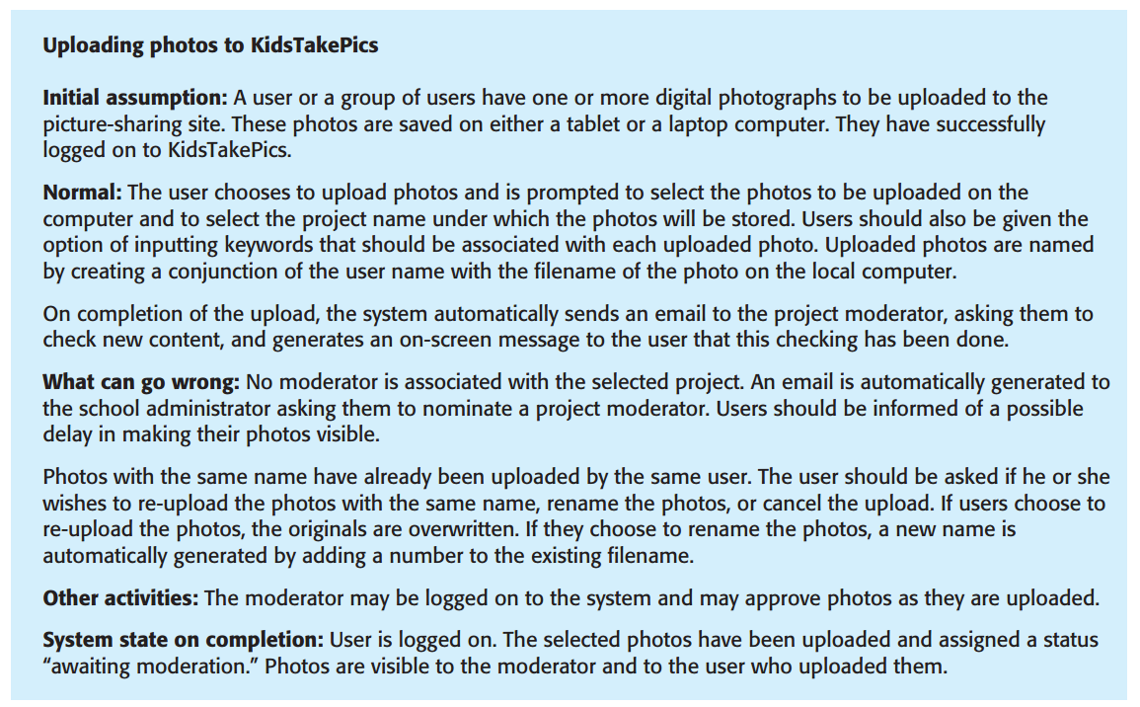
Scenario: Example (Textbook)

Slide 33
Scenario: Example
Check the Additional handout that goes along with this week's lecture
Scenario Example.docx

Slide 34
Requirements Specification

Slide 35
Recap
We covered the various ways in which Requirements can be specified in the previous Lecture (refer Lecture 5)
In the following couple of slides, we present, in brief, candidate structure for the SRS
Note that the IEEE 830 – 1998 standard for the SRS allows room for customization (in certain sections of the document), and merely proposes an outline (which you will see in the following slides)

Slide 36
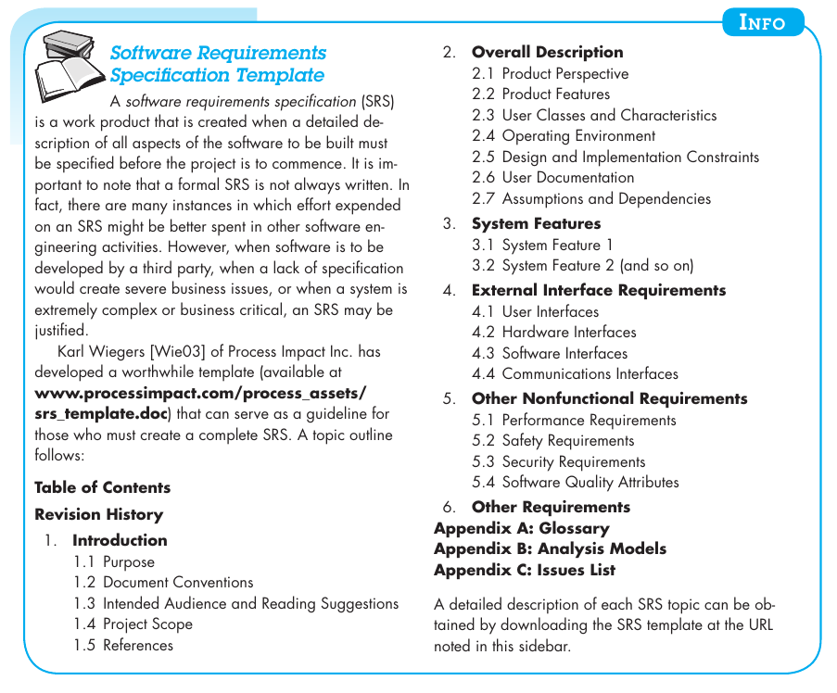
Software Requirements Specification (PRE., pg. 136)

Slide 37
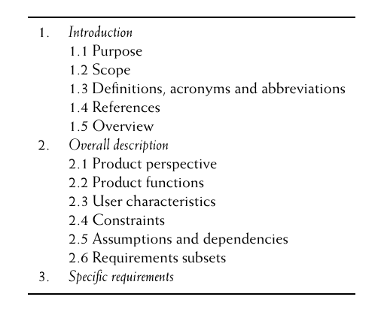
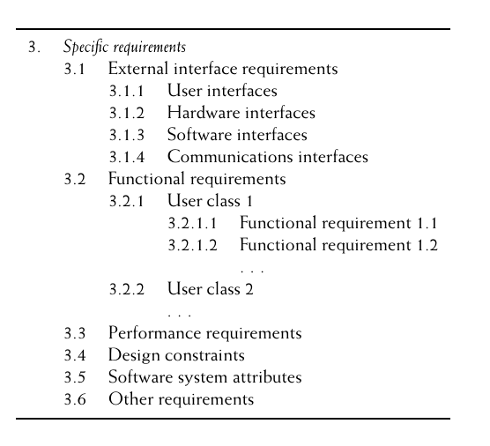
Software Requirements Specification – IEEE 830 (Hans Van Vliet, pg. 231)

Slide 38
Software Requirements Specification – IEEE 830 (Hans Van Vliet)
Refer pg. 232 to pg.234 for a brief example of the fields of the SRS (using a library system)

Slide 39
Requirements Validation

Slide 40
Introduction
"Process of checking that requirements define [capture the essence of] the system that the customer really wants"
Essence – meets customer expectations and goals, apart from being clear and feasible
Can overlap with elicitation and analysis, as it is concerned with finding problems with the requirements
Critically important since errors in requirements document can lead to extensive rework

Slide 41
Checks in Requirements validation
Validity checks: These check that the requirements reflect the real needs of system users
Consistency checks: Requirements in the document should not conflict
Completeness checks: The requirements document should include requirements that define all functions and the constraints
Realism checks: (by using knowledge of existing tech.,) ensure that system can be implemented in time and budget constraints
Verifiability: System requirements should always be written so that they are verifiable

Slide 42
Checks in Requirements validation - Example
Validity Check:
Does the student portal actually help students register for courses in a way that matches their real needs and expectations? (simply: does it do what it is supposed to do)
Consistency Check:
If one requirement states that students can reset their password via email, another requirement should not say that password resets are only possible through the IT helpdesk
Completeness Check:
The student portal requirements should include course registration, fee payment, grade viewing, and any necessary constraints (e.g., prerequisite enforcement)
Realism Check:
A requirement that says "The student portal should process 1 million registrations per second" is unrealistic given the university’s current infrastructure and budget
Verifiability Check:
The system should allow students to reset their password within 5 minutes of requesting a reset link (this can be tested and measured)

Slide 43
Requirements validation techniques
Requirements reviews: The requirements are analyzed systematically by a team of reviewers who check for errors and inconsistencies
Prototyping: This involves developing an executable model of a system and using this with end-users and customers to see if it meets their needs and expectations (stakeholders use prototype and feedback changes to requirements, if any)
Test-case generation: Requirements should be testable. If the tests for the requirements are devised as part of the validation process, this often reveals requirements problems. If a test is difficult or impossible to design, this usually means that the requirements will be difficult to implement and should be reconsidered. Developing tests from the user requirements before any code is written is an integral part of test-driven development.

Slide 44
How does test case generation help with requirements validation?
Confirms Functional Coverage
Each test case is designed based on a requirement. One to one mapping. If test cases cover all requirements, it confirms that the system meets the intended functionality.
Identifies Missing or Ambiguous Requirements
If a test case cannot be created for a requirement, it may indicate ambiguity or missing details.
Example: If a requirement states, "The system should allow users to reset their password," but does not specify constraints (e.g., password complexity rules), test case generation will highlight this gap.
Detects Incorrect or Conflicting Requirements
If a test case fails, it could mean the requirement is incorrect, unrealistic, or conflicting with another requirement.
Example: One requirement says, "Users must be logged in to view reports," but another says, "Users can access reports without logging in." Test cases will reveal this inconsistency
Example: One requirement says, "Students must be able to register for any course at any time, without any restrictions." Here the test case might reveal that the requirement is incorrect since universities allow registration at start of semester

Slide 45
How does test case generation help with requirements validation?
Ensures Testability of Requirements
If a requirement cannot be tested, it may be too vague or non-measurable.
Example: "The system should be user-friendly." This is subjective and cannot be directly tested, so it needs clearer criteria like "The system should load within 2 seconds."
Validates Business Logic and User Scenarios
Test cases simulate real-world usage to check if the system aligns with business needs and user expectations
Example: A test case simulates students accessing their grades to verify that only authorized students can view them, or only authorized professor(s) can assign and publish grades. This way, the test case ensures that business logic and user scenarios are satisfied

Slide 46
Requirements Management

Slide 47
Introduction
The requirements for large software systems are always changing
Due to "wicked" problems - problems that cannot be completely defined (example in next slide)
During the software development process, the stakeholders’ understanding of the problem is constantly changing
Once a system has been installed and is regularly used, new requirements inevitably emerge (sometimes this is due to omission in original requirements) - oft stated gaming example in class
Also, changes to system requirements may also arise because of changes to the business environment (see slide 49)

Slide 48
Feeling a little … wicked
Requirement: "A university wants to implement a Dynamic Student Feedback System in a university portal"
Hard to define! Why? Student expectations, faculty preferences, university policies are evolving
Initially – End of semester feedback
Then – students request removal of forced feedback (having to provide feedback for profs who do not teach them)
Then – Some course faculty consider real-time mid semester feedback
Then – Administration says bias and misuse might happen with dynamic feedback (but then faculty says no problem, we will have moderation)
Then – Admin says why not have AI based sentiment analysis, but privacy regulations come in the way (can you really take something shared discreetly and in privacy and feed it to a system?)
These shifting needs make it difficult to finalize a stable set of requirements, leading to continuous modifications in the system

Slide 49
Changes in Business Environment
The business and technical environment of the system always changes after installation. New hardware may be introduced and existing hardware updated (new OS has packages which are incompatible with software). Business priorities may change (use cisco webex instead of messenger)
The people who pay for a system and the users of that system are rarely the same people
Large systems usually have a diverse stakeholder community, with stakeholders having different requirements

Slide 50
Requirements Management
As requirements are evolving, you need to keep track of individual requirements and maintain links between dependent requirements so that you can assess the impact of requirements changes
Requirements management: "Formal process for making change proposals and linking these to system requirements"
This process of “requirements management” should start as soon as a draft version of the requirements document is available
In many cases, users prioritize change
Users are not necessarily the best people to decide if the change is worth it (cost effective)
Therefore, independent authority, who balances needs of all stakeholders, should decide on which changes need to be accepted

Slide 51
Requirements Management: Example
In a university portal
Initially - course registration system allows students to enroll in courses based on prerequisites
Then - university introduces a waitlist feature, requiring changes to enrollment logic (wait for a while before finalizing courses)
Then - administrators request automated prerequisite overrides for exceptional cases, impacting both the registration and waitlist modules
To manage these evolving requirements, developers maintain traceability links between related requirements, ensuring that changes in prerequisite handling do not break waitlist logic or grade verification rules. This tracking helps assess the impact of changes, preventing unintended disruptions in the system

Slide 52
Requirements Management Planning
Requirements management planning: Answers the question – how will you manage evolving requirements?
During the planning stage (within RE), decide on:
Requirements identification: Each requirement should have a unique ID so it can be tracked with respect to other requirements
Change management process: Set of activities that assess the impact and cost of changes (slide 55)
Traceability policies: Policies define the relationships between each requirement and between the requirements and the system design (slide 53)
Tool support: Since this task can get tricky, you can decide on what tools to use for automation support before starting requirements planning

Slide 53
Traceability policies
Help manage requirements changes by linking related features to ensure consistency
A well-defined traceability policy ensures that any modification in a requirement is tracked and assessed across all dependent requirements, preventing inconsistencies
Example policy: Use a traceability matrix
By maintaining traceability matrices, developers can evaluate the impact of the change

Slide 54
Example: From Grades to Pass / Fail
Requirement ID | Requirement Description | Related Module(s) | Dependency | Status
REQ-101 | Update grading policy to include Pass/Fail option | Grading System | Affects GPA calculation, transcript generation | Approved
REQ-102 | Modify GPA calculation logic for Pass/Fail courses | GPA calculation | Dependent on RQ-101 | In Progress
REQ-103 | Update transcript format to reflect Pass/Fail grades | Transcript Generation | Dependent on RQ-101 | Pending
REQ-104 | Ensure academic standing rules account for Pass/Fail courses | Academic standing module | Dependent on RQ-102 | In Progress
REQ-105 | Modify course eligibility checks to support Pass/Fail prerequisites | Course Registration | Dependent on RQ-101 | Approved
REQ-106 | Update student and faculty portals to display Pass/Fail grades | Student and Faculty Portal UI | Dependent on RQ-101 & RQ-103 | Pending

Slide 55
Change Management Process
Ensures that modifications to a system are evaluated, approved, and implemented without disrupting existing functionality
Three stages:
Problem Analysis and Change Specification: Problem or change proposal analyzed for validity. Might go back to requestor for more specific change request or dropping change request
Change Analysis and Costing: Effect assessed using traceability information. Cost in terms of changes to requirement document, design and implementation (if need be). At end of this phase, final call taken to go ahead with requirement change or not
Change implementation: Requirements document, and where necessary, design and implementation are modified (any project artefacts should be so made that changes do not incur extensive rewriting or reorganization)

Slide 56
Prioritizing Requirements

Slide 57
Introduction
In most cases, not all requirements can be realized, so we have to make a selection of requirements which need to be realized first / on priority

Slide 58
Triage
Triage in requirements prioritization refers to the process of evaluating, categorizing, and ranking requirements based on their importance, urgency, and feasibility—similar to how medical triage prioritizes patients based on the severity of their condition
Why triage?
Projects often have limited resources, time, and budget, so some requirements need to be fulfilled before others
Triage helps identify the most critical requirements to work on first

Slide 59
Triage – How it works
Critical (Must-Have) – These are essential for the system to function. Without them, the project fails or does not deliver its core value.
Example: A student portal must allow students to register for courses.
Important (Should-Have) – Highly desirable but not immediately essential. These can be added in later phases or releases.
Example: A student portal should allow students to receive notifications when a waitlisted course becomes available.
Optional (Nice-to-Have) – Enhancements that improve user experience, not urgent/ critical, can be postponed or removed
Example: A chatbot assistant for answering student FAQs within the portal.

Slide 60
Triage – Example using student portal
Requirement | Priority
Student login | Critical
View grades | Critical
Course discussion forum | Important
Dark mode interface | Low

Slide 61
MoSCoW (Hans Van Vliet, pg. 226)
Distinguishes four types of requirements:
Must haves: These are top priority requirements (ones that definitely need to be realized in order to make system acceptable to customer)
Should haves: Not strictly mandatory (but highly desirable) - important but not show stoppers
Could haves: If time allows, these requirements will be realized (in practice, they usually won't) - desirable but low priority
Won't haves: These requirements will not be realized in the present version (they are recorded though. They will/ might be considered again for a next version of the system) - low value, high cost (in terms or time or budget)
"MoSCoW assumes that requirements can be ordered along a single axis, and that realizing more requirements yields more satisfied customers (reality is more complex)" - this is where Kano comes

Slide 62
MoSCoW: In simpler terms
Distinguishes four types of requirements:
Must haves: Essential requirements; system will fail without them
Should haves: Important but not critical; workaround may exist
Could haves: Desirable features if time permits
Won't haves: Not included in the current version
Example:
Requirement | Priority
Student login | Must Have
View grades | Must Have
Attendance viewing | Should Have
Profile picture upload | Could Have
AI course recommendation | Won’t Have (for now)

Slide 63
How to prioritize using MoSCoW?
List all requirements
Identify key features & functions
Assess impact & dependencies
Can the system work without it?
Categorize each requirement
Based on business needs & feasibility
Get stakeholder agreement
Ensure alignment with all (most) stakeholders
Adjust based on project constraints
Budget, time, and resources.

Slide 64
Kano model (Hans Van Vliet, pg. 226)
Preferences classified into five categories:
Attractive: More satisfied if these requirements are met, but not less satisfied if they are not
Must-be: Will be dissatisfied if these requirements are not met (but will not be overly happy if they are met)
One-dimensional: Satisfaction is proportional to how many of these requirements are being met
Indifferent: Customer does not really care about these requirements
Reverse: Customer's judgement of the requirements is the opposite of what the analyst thought a priori
Questionable: Customer's preferences are not clear

Slide 65
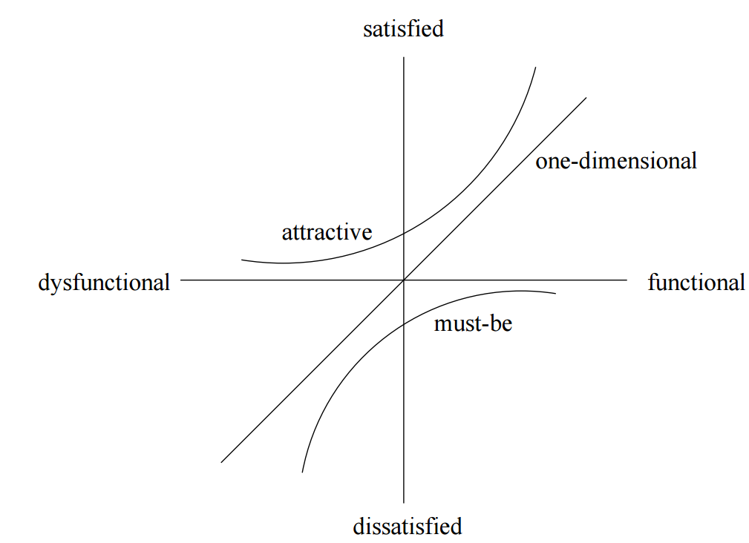
Kano model (Hans Van Vliet, pg. 226)
The way customers value the Attractive,
Must-be and One-dimensional categories of requirements is depicted in figure.
This figure shows that offering attractive, so called killer features, is what will really excite your customers.
"Our task is not to provide every button and pull-down menu enhancement that our
customers ask for, but to invent a completely new way of working -- one that will thrill and amaze them." - (Robertson, 2002)

Slide 66
Kano (put another way)
Focuses on customer satisfaction rather than just importance
Think of it this way:
Satisfaction behavior:
Category | Meaning
Basic Needs (Must-be) | Expected features; if missing, users are dissatisfied.
Performance Needs (1-dimensional) | More of the feature increases satisfaction.
Excitement Needs (Delighters) | Unexpected features that delight users.
Feature Type | If Missing | If Present
Basic | Very dissatisfied | Neutral
Performance | Dissatisfied | More satisfied
Excitement | Neutral | Highly satisfied

Slide 67
Kano (example – student portal)
Basic Requirement
Student must be able to login
Performance Requirement
Faster login response time
Excitement Requirement
AI assistant suggesting courses

Slide 68
Comparison of the three models
Model | Focus | Typical Use
Triage | Urgency and impact | Bug fixing, crisis management
MoSCoW | Release planning | Agile projects
Kano | Customer satisfaction | Product design and UX

Slide 69
Which model to choose?
Rule of thumb
Based on Project Type
If you want to prioritise based on… | Use
Urgency | Triage
Release importance | MoSCoW
User delight | Kano
Project Type | Recommended Model
Agile software development | MoSCoW
Product design / UX-heavy systems | Kano
Maintenance and bug management | Triage
Based on goal
Goal | Suitable Model | Reason
Handle urgent issues or bugs | Triage | Focuses on urgency and severity
Plan features for a release | MoSCoW | Helps decide what goes into the current version
Improve customer satisfaction | Kano | Focuses on how features affect user happiness
Based on stakeholder involvement
Situation | Model
Many stakeholders with conflicting demands | MoSCoW
Focus on user satisfaction research | Kano
Internal technical prioritisation | Triage

Slide 70
Further reading / browsing (if interested)
NLP for Requirements Engineering (NLP4RE) - ACM Journal Survey Article
Summary of the first workshop of NLP4RE - IEEE Journal
Requirements elicitation using Generative AI based NLP tools – Conference Article
Requirements Engineering – Springer Journal

